Slide 1
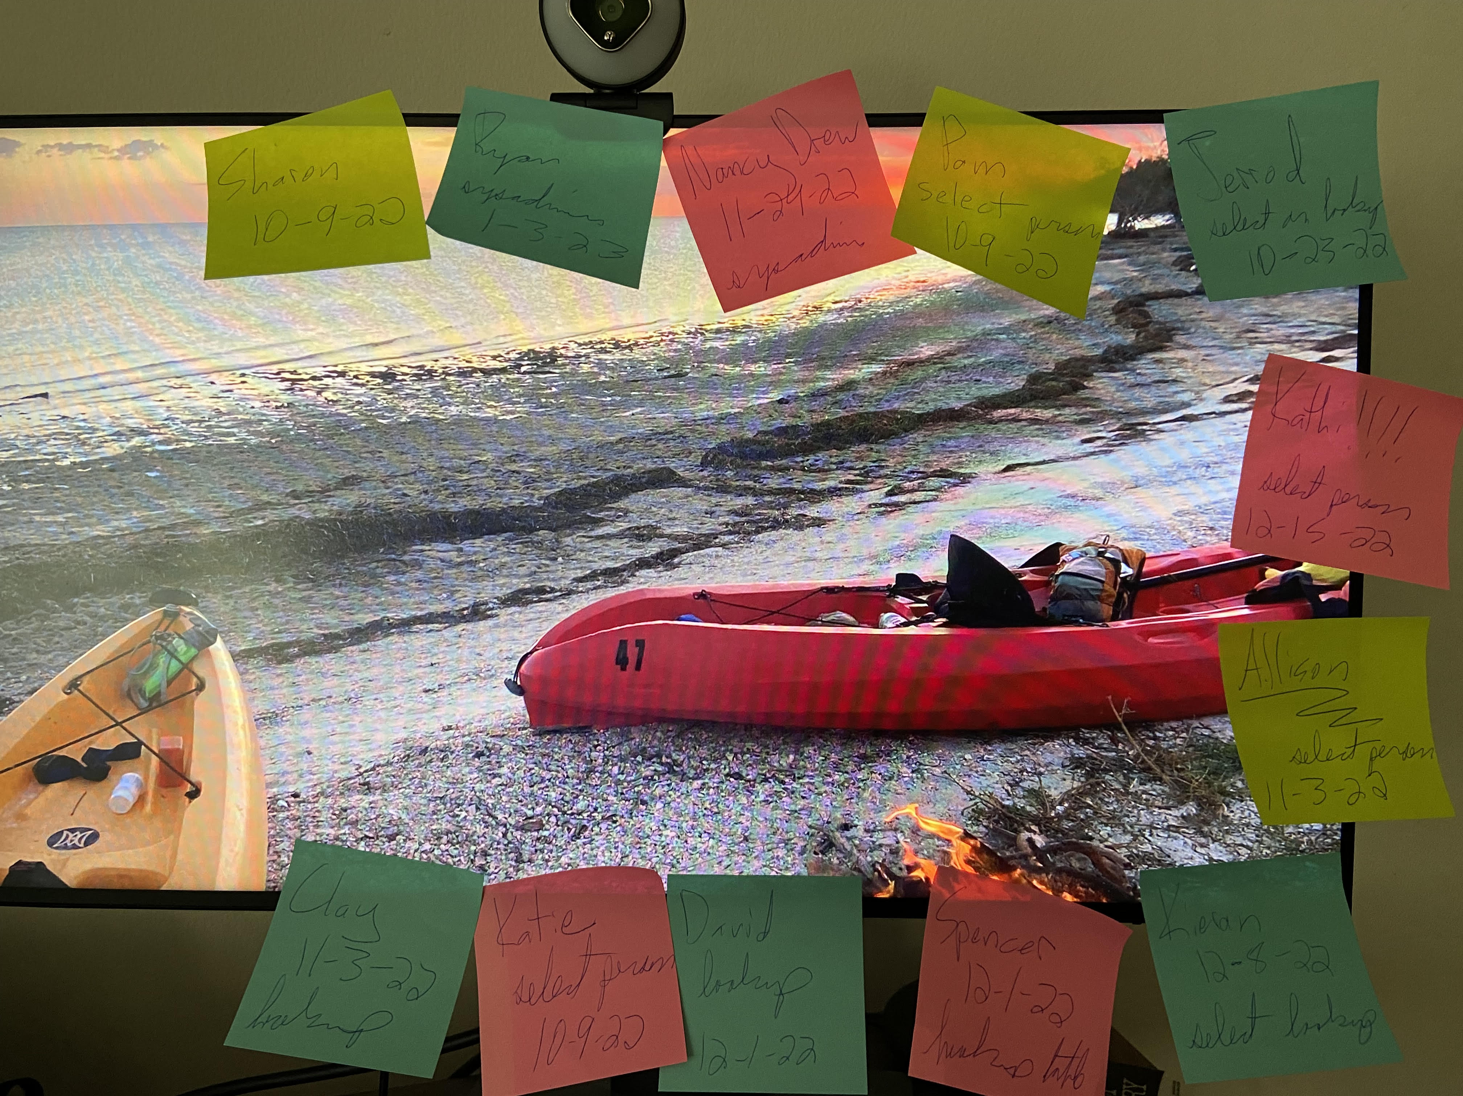
Ditching the Post-Its: Automating Temporary Database Permissions
Sharon Reid
sharon.reid.harris@gmail.com
https://github.com/InfoJunkie1/TempPerms
dataMinds
22 Nov. 2023

Slide 2
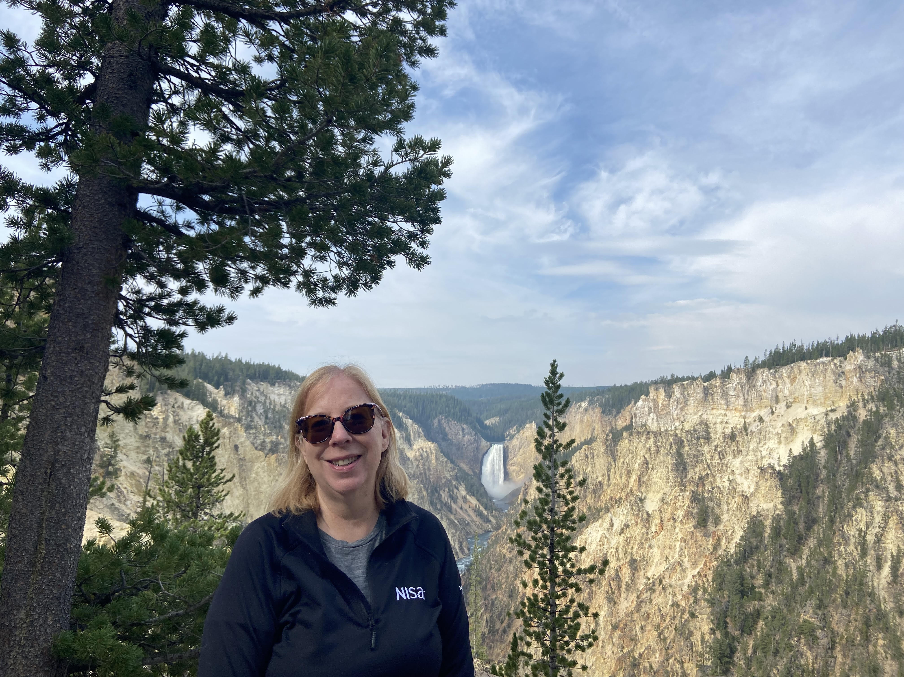
About Me
High school and then college writing instructor
Needed full-time job!
Went through LaunchCode SQL cohort
Hired at NISA!
Asked to come back and TA and then be a lead mentor
St. Louis SQL Server and BI user group speaker and advisory board
Passionate about database security
(Yellowstone—Artist Point)
Notes:
High school and then college writing instructor
Needed full-time job!
Saw Tweet re CoderGirl @ 2 a.m.
Went through LaunchCode
Hired at NISA!
Asked to come back and TA and then be a lead mentor
LaunchCode changed my life and now give back for others
St. Louis SQL Server and BI user group speaker and advisory board
Passionate about database security

Slide 3
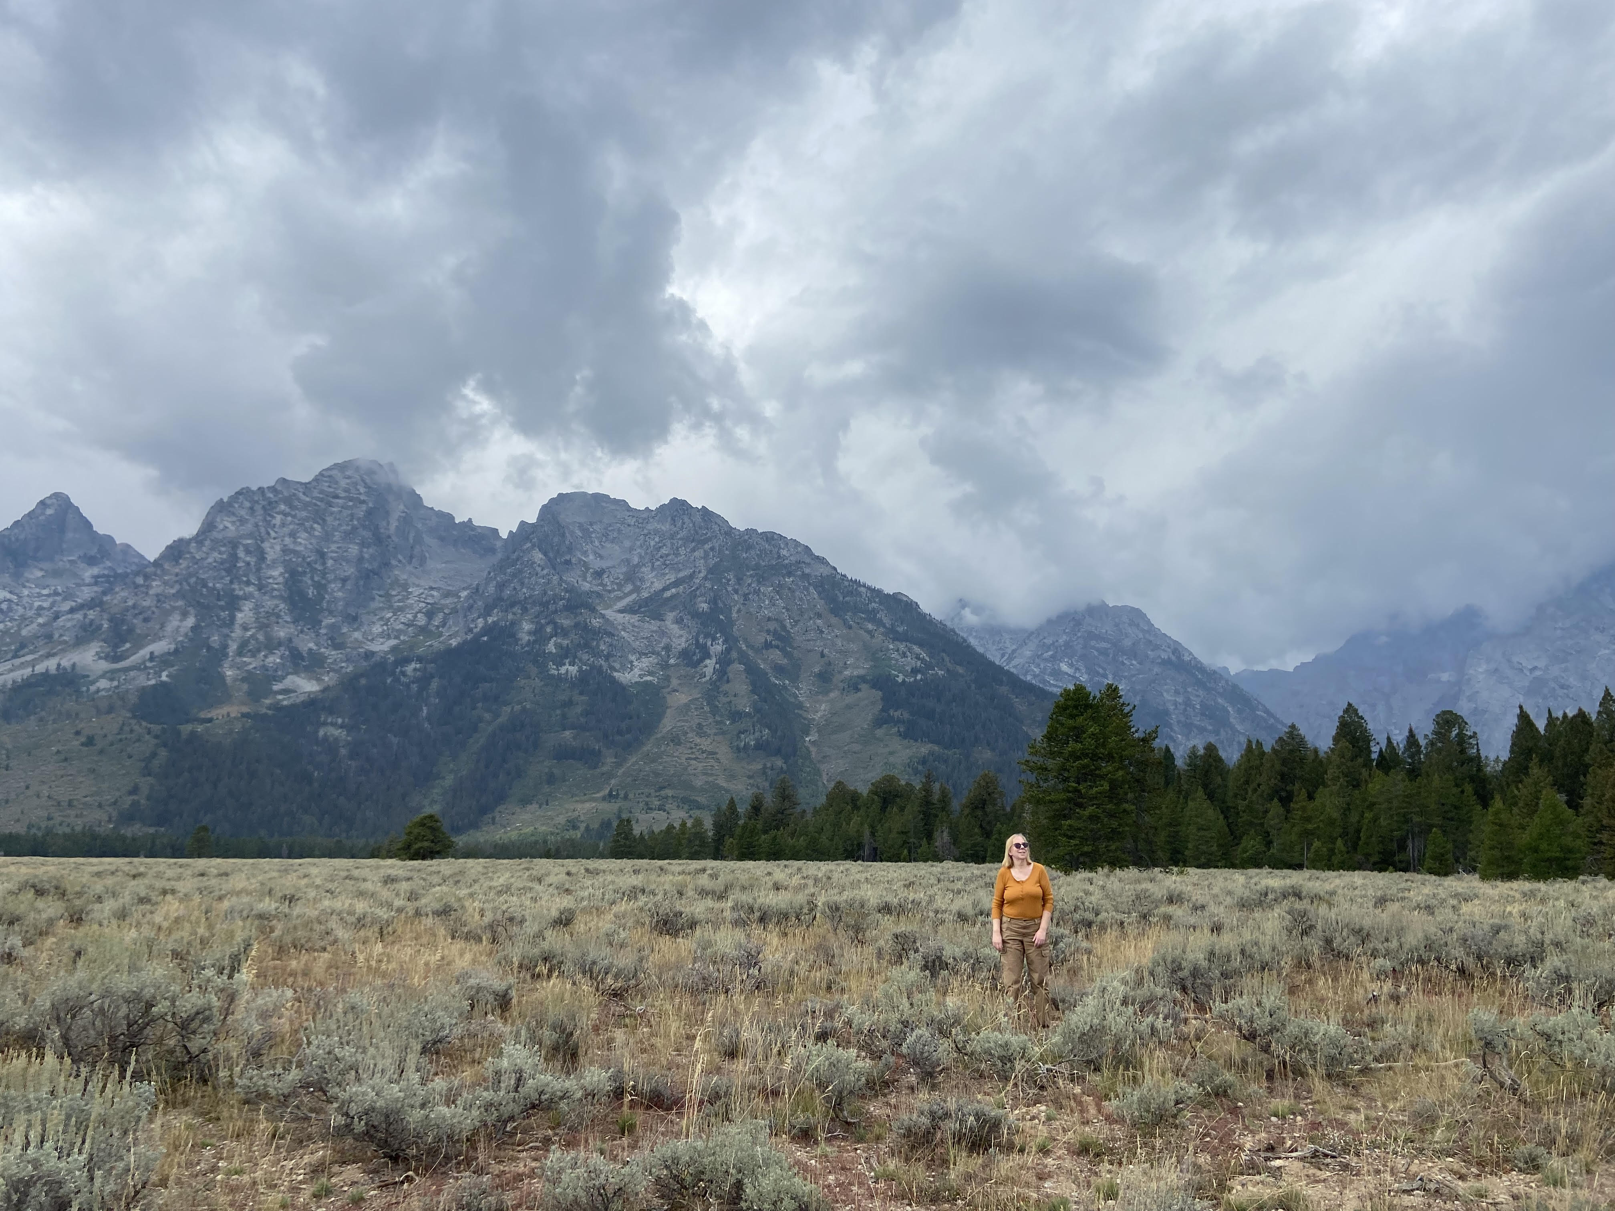
Expectations
Not introductory, not in the weeds—passion to help others on the journey to improve database security
Basic knowledge of how permissions work
Login vs user
Role
Securables
(Grand Tetons)
Notes:
Ask questions! Put in chat

Slide 4

Principle of Least Privilege
Security principle to only provide access to what people need when they need it
Securables! Specific objects such as tables, views, stored procedures or schemas that we can grant or deny permissions on
Temporary! Don’t grant permanent permissions needed for troubleshooting an issue
(Yellowstone)

Slide 5
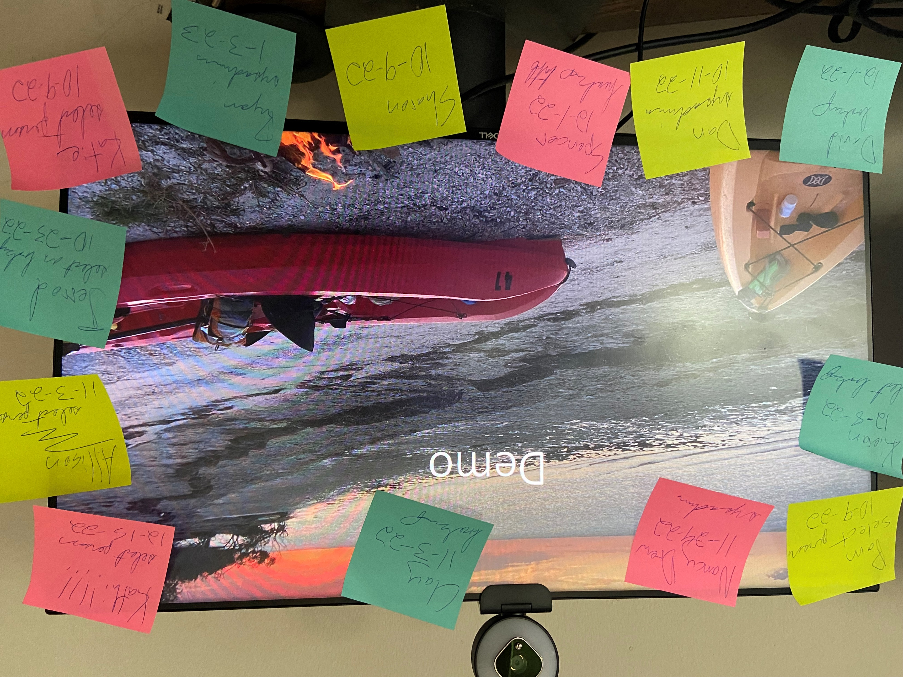

Slide 6
Version 1—Post-Its!
(Everglades—Kayak camping)

Slide 7
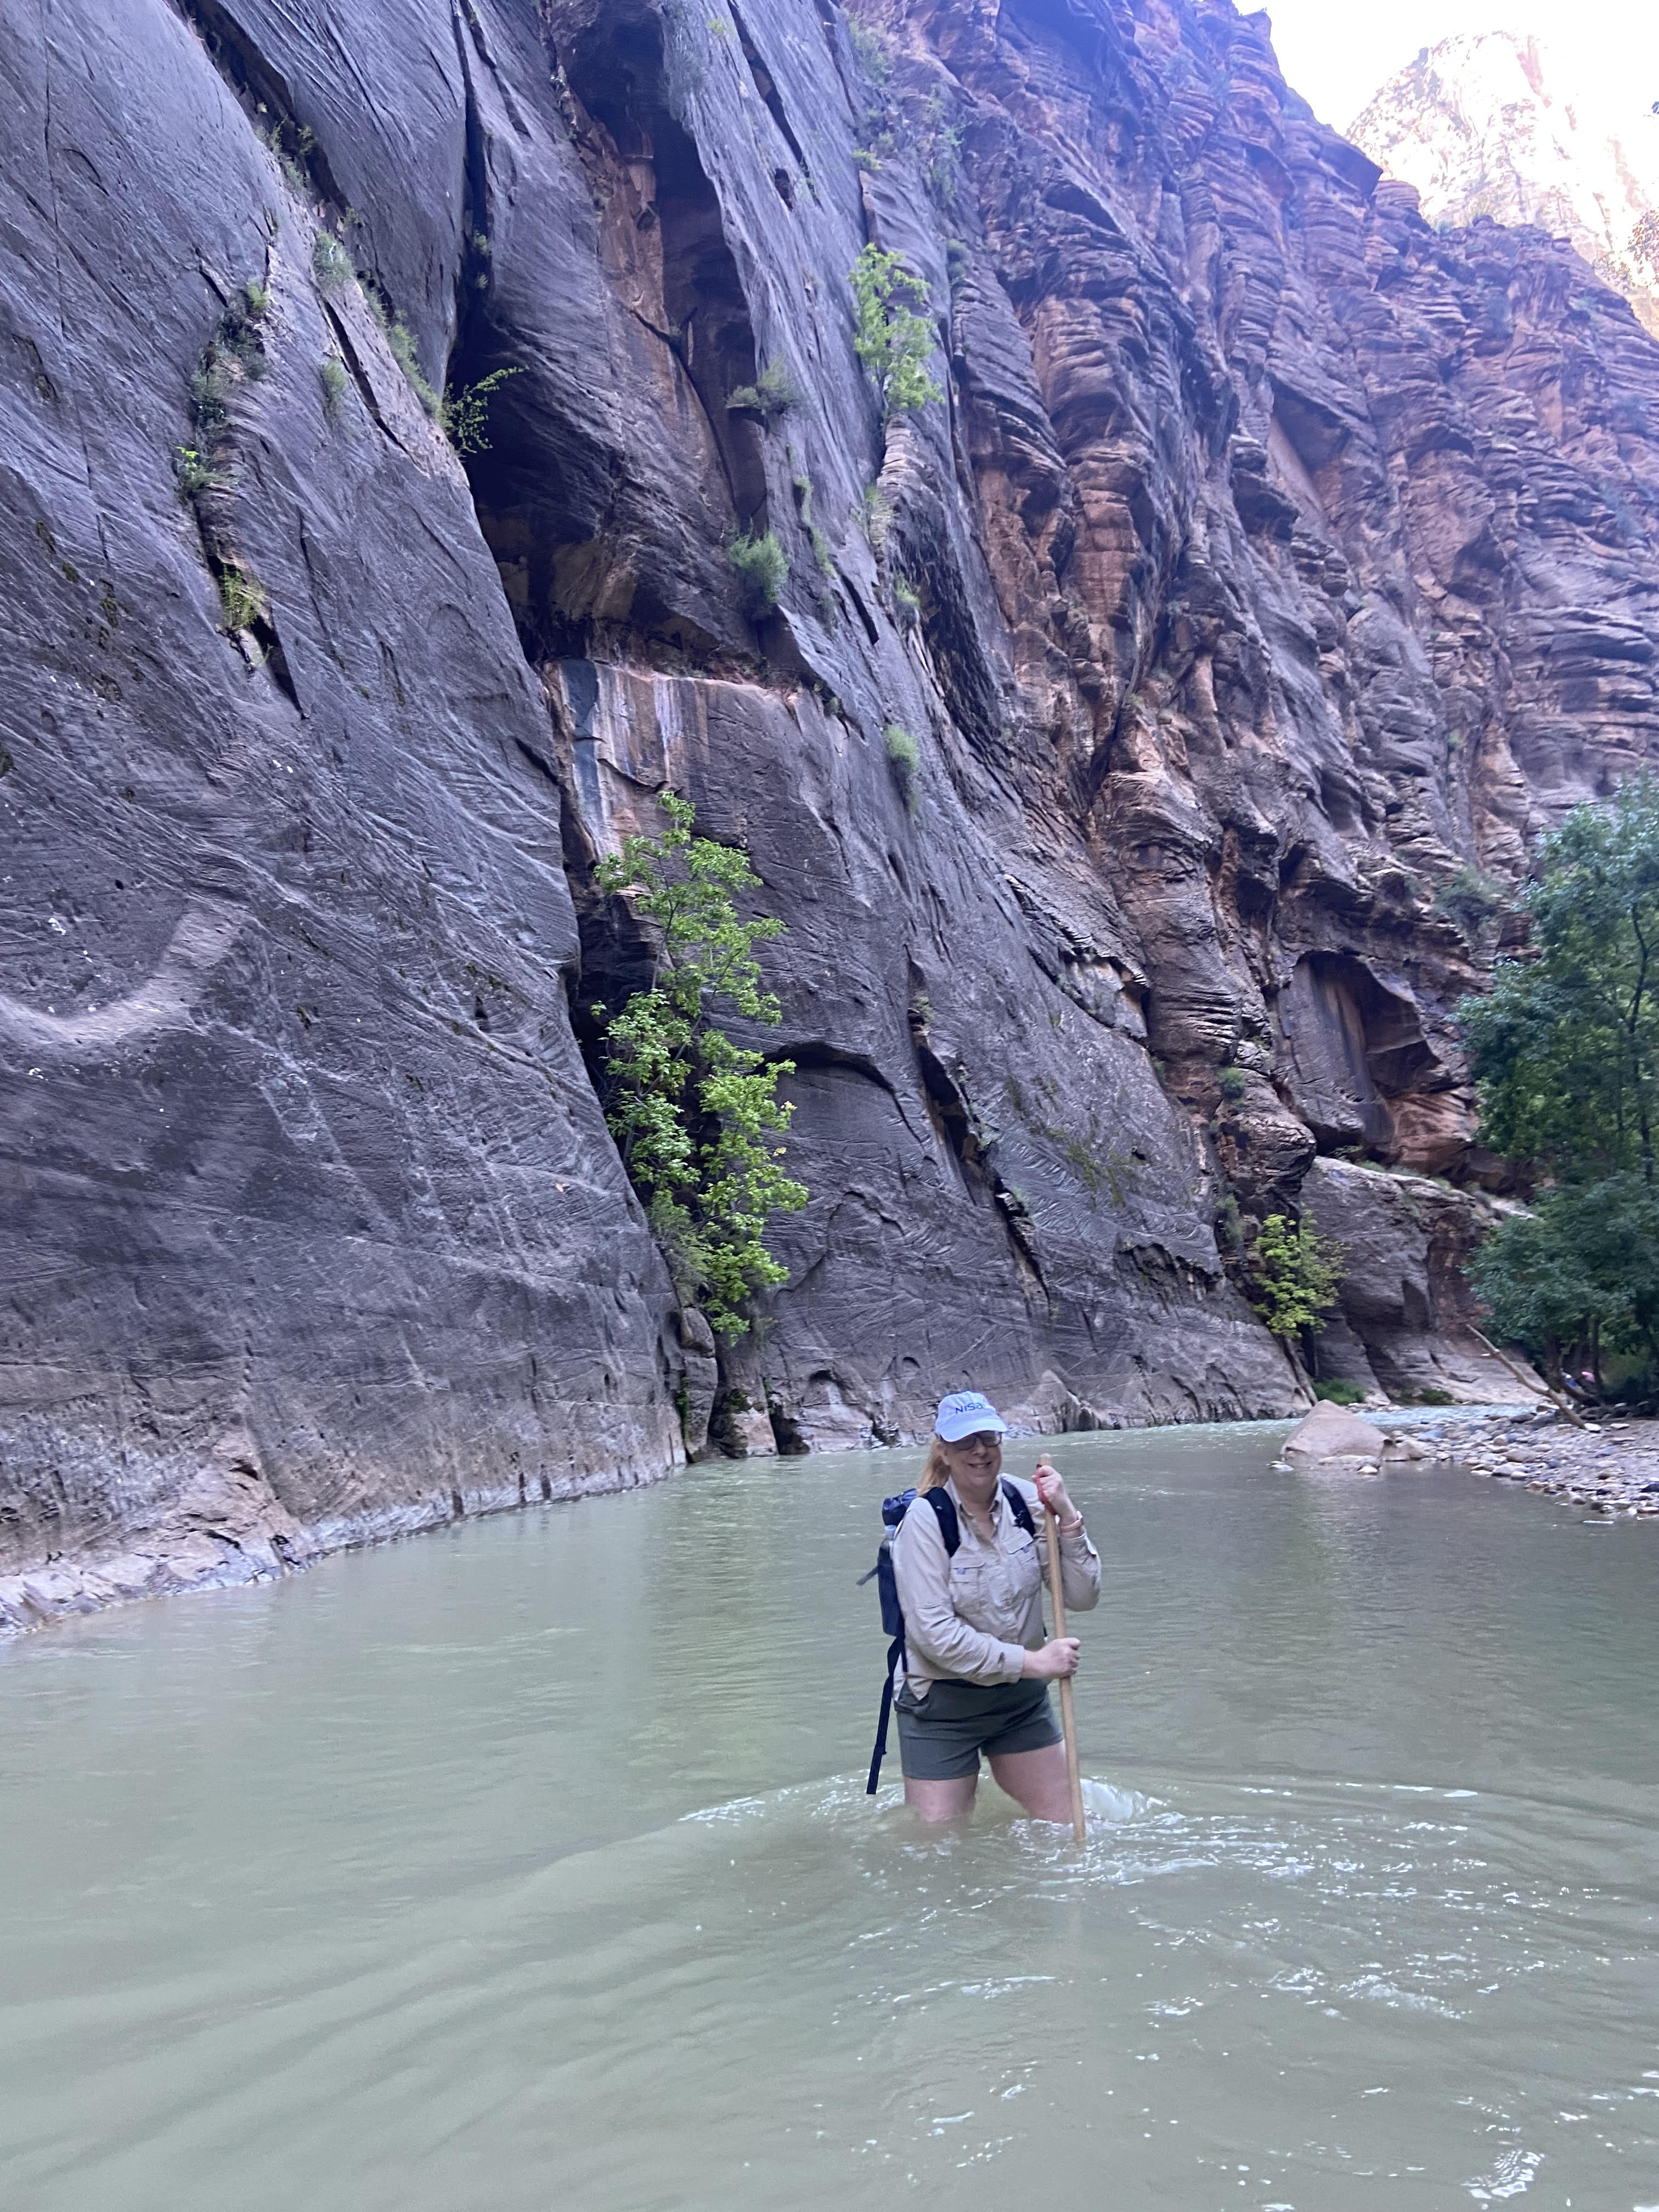
Version 2—Reminder table and email
(Everglades—my daughter Allison Harris)
(Zion--Narrows)

Slide 8

Extra work!
Enter data in table after granting the perms
Forward expiration email
Delete the perms
(Everglades—my daughter Allison Harris)

Slide 9
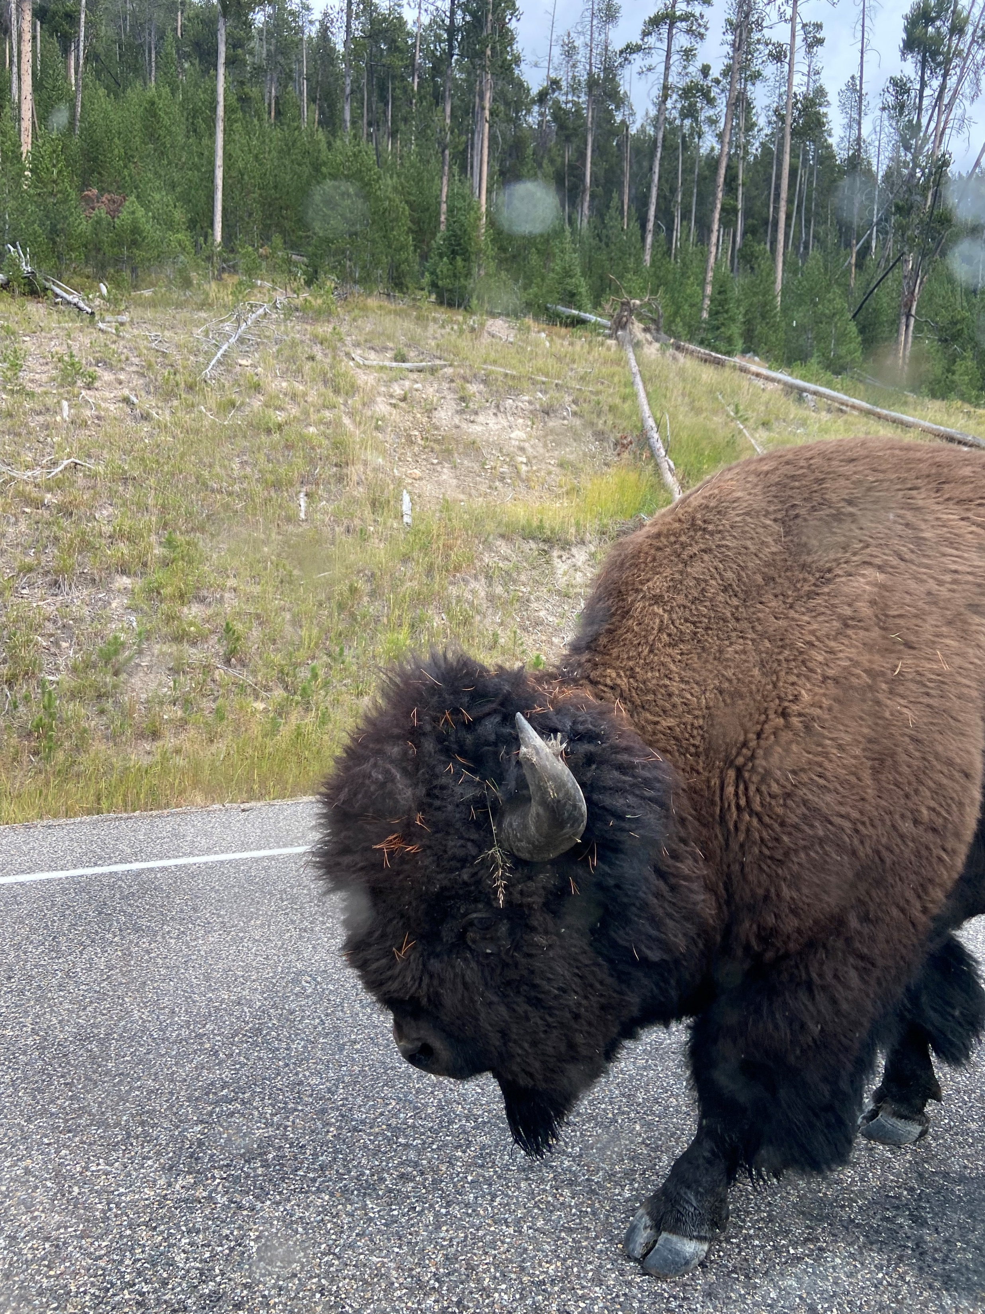
Version 3—Automated Process
https://github.com/InfoJunkie1/TempPerms
(Yellowstone)
Notes:
Process doesn’t get into Azure but was developed on-prem

Slide 10
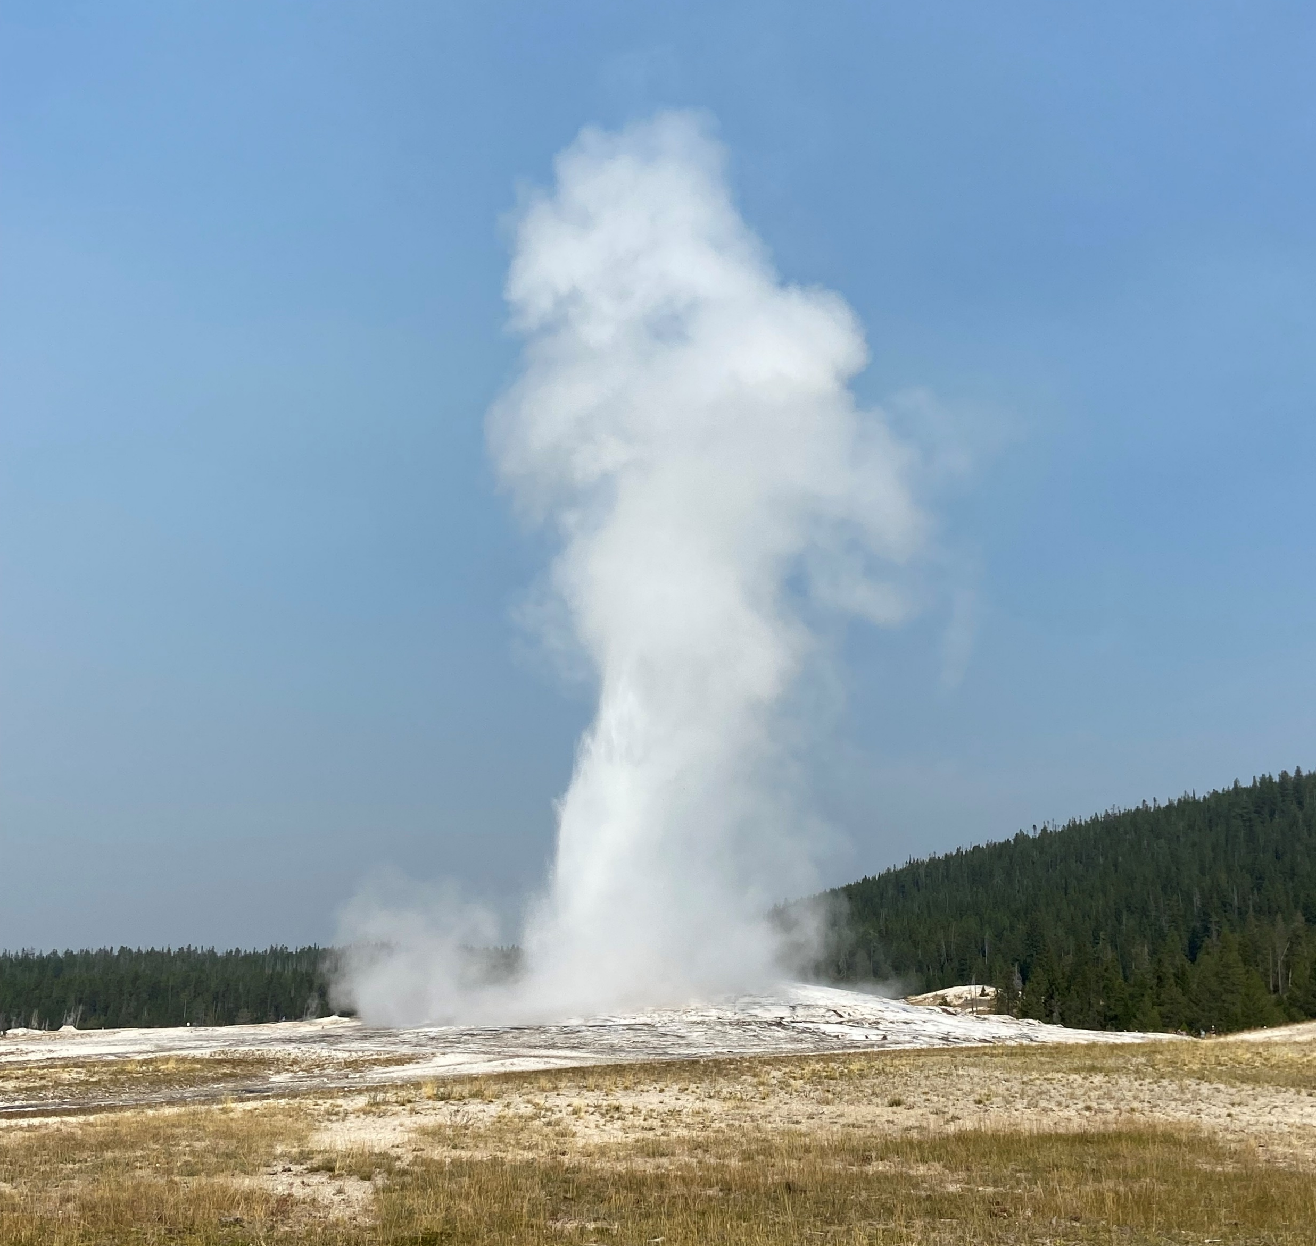
Demo—6 examples
Database level with role
Database level with securables
Server level with role
Server level with securables
Error handling with no SQL authenticated login
User in table but no longer in database
(Yellowstone—Old Faithful)

Slide 11
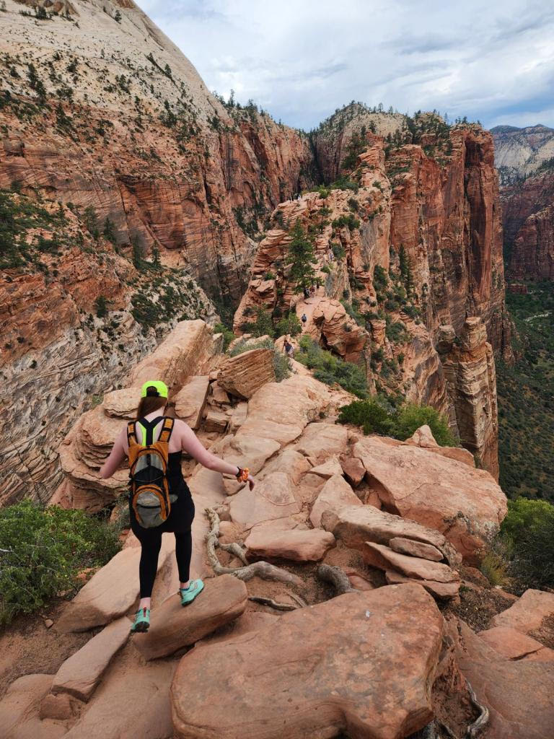
Contact info
sharon.reid.harris@gmail.com
https://github.com/InfoJunkie1/TempPerms
@Edudiva on Twitter
@edudiva@dataplatform.social on Mastodon
@edudiva.bsky.social on Bluesky
linkedin.com/in/Sharon-reid-44433654 on LinkedIn
(Angel’s Landing at Zion—my daughter Allison Harris)

